Slide 1

Virtue Ethics in Psychotherapeutic Practice
Dr Carmel Proctor, PhD
IMEC International Meaning Conference
12-14 July, 2019
carmel@pprc.gg
www.pprc.gg

Slide 2

Outline
Virtue Ethics
Aristotle
Links with Positive Psychology
Literature Review
Weaving Virtue Ethics Into Psychotherapeutic Practice
Weaving Virtue & Character Strengths Into Psychotherapeutic Practice
Vignettes
Relevance to Psychotherapy
  (Perelle Bay, 2017 )

Slide 3
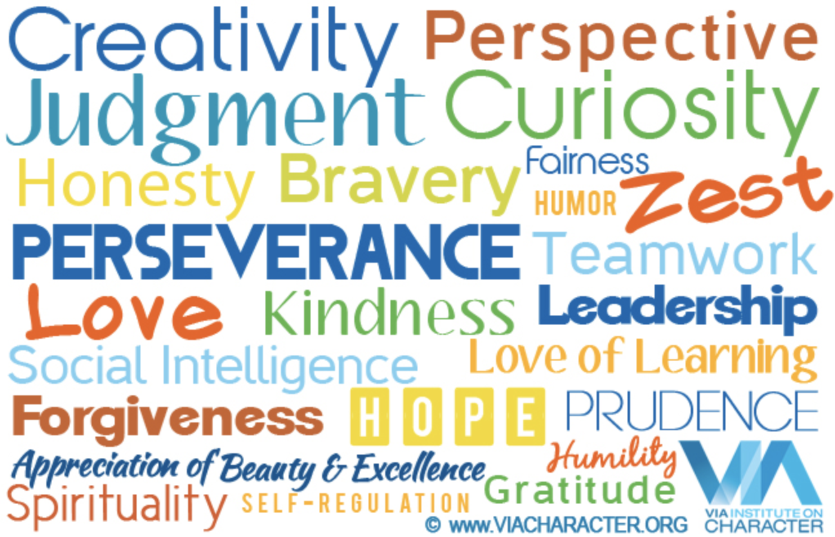
Disambiguation: Values, Virtues & Character Strengths
Value – right conduct and good life
  Degree of importance of some thing or action, such that highly valuable action is regarded as ethically ‘good’
Virtue – moral excellence
  Trait or quality deemed to be morally good and valued as such
Character Strengths – expression of virtue
  Processes or mechanisms that define virtues
  Pathways to virtues

Slide 4
Virtue Ethics
One of three major approaches to normative ethics
  The study of ethical action
Virtue Ethics focuses on the inherent character of a person and their expression of virtue
  Virtue ethics is character-based
  Emphasises practical wisdom in the application of character and virtue, not universal principals to be applied across moral situations
    Deontology (duty) and Consequentialism (outcomes)
Based on Aristotelian philosophy

Slide 5
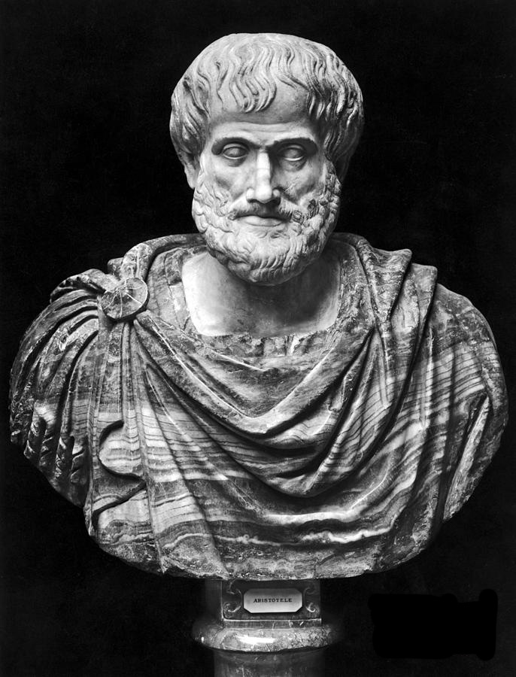
Aristotle
Aristotelian philosophy
  Primary function of humans is to exercise good character through the conscious choice of action in the pursuit of eudaimonia (human flourishing)
  Practical wisdom
    ‘Golden mean’ – Acts must be done ‘at the right times, with reference to the right objects, towards the right people, with the right motive, and in the right way’
    (Aristotle, c. 330 BCE/1925, p. 38)

Slide 6

Virtue Ethics: Aristotle
Virtue ethics deal with wider questions
  How should I live?
  What is the good life?
  What kind of persons should we be?
‘What is the right action?’ is an entirely different question from ‘How should I live?’
Aristotle suggests that the exercising of virtue provides meaning to being and thus is our ultimate function
By choosing to practice virtue, we become by nature the very thing that we strive for
We must practice virtue to become virtuous
  Once established character becomes stable/reliable
  A person with a certain character can be relied upon (within) reason to act consistently over time
(Athanassoulis, 2016; Sachs, 2016)
Notes:
Once established become stable/reliable – a person with a certain character can be relied upon (within reason) to act consistently over time

Slide 7

Virtue Ethics: Aristotle
Aristotle argued for habituation into virtue
  Becoming virtuous by practicing virtue – making virtuous characteristics/ dispositions our own
  Adopting a way of being, such that we become our choices
    Akin to making a lifestyle choice

Slide 8

Virtue Ethics: Aristotle
True virtue requires choice, understanding, and knowledge
  Virtue is chosen knowingly for its own sake
  This is what constitutes character
  Not the result of ‘conditioning’
Aristotelian character is about a state of being
  Character is also about doing
  Good acts must be done with the knowledge and desire to do them because they are good in order to be virtuous
  Virtue feels good – doing apparently virtuous actions out of painful duty indicates that the underlying virtue has not yet been attained

Slide 9

Virtue Ethics: Aristotle
Eudaimonia is a process requiring habituation
  Working actively towards the objectively desirable life throughout the lifespan
Virtue itself is not a habit
  Habituation is an aid to the development of virtue
Matter of experience
  Virtuous character/disposition takes a long time to develop
Virtue involves emotion
  Activity of the soul

Slide 10

Moral Virtue: Being Human
‘Human nature is such that virtue is not exercised in opposition to self-interest, but rather is the quintessential component of human flourishing. The good life for humans is the life of virtue and therefore it is in our interest to be virtuous. It is not just that the virtues lead to the good life (e.g., if you are good, you will be rewarded), but rather a virtuous life is the good life because the exercise of our rational capacities and virtues is its own reward.’
The exercising of virtue is the actualisation of our being (Dahlsgaard et al., 2005)
  Evolutionarily adaptable
  Predisposed socialisation of the ‘moral animal’
  Rational
(Athanassoulis, 2016)

Slide 11
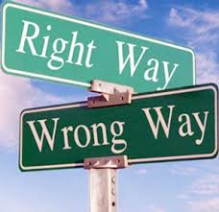
Positive Psychology: Links with Aristotle
Positive psychology aligns itself with Aristotle’s view of a biological basis for good character and psychological growth from activities that exercise our capabilities
  We are born with all sorts of natural tendencies (i.e., positive and negative) – this is our ‘raw material’
  Natural tendencies can be encouraged and developed or discouraged and thwarted during development
  Character strengths are not ‘grounded in immutable biogenetic characteristics’ (Peterson, 2006)
  Character is about doing
    Positive psychology is not a spectator sport (Peterson, 2006)
  Virtue manifests itself in action (Niemiec, 2013; Sachs, 2016)

Slide 12
Virtue Ethics in Psychotherapy: Literature Review
Systematic review of the literature
  Psychotherapy and Virtue Ethics
  21 abstracts identified for review
Seven retained:
  On psychology and virtue ethics (Richardson, 2012)
  Virtue Ethics in practice: The Greenbrier Academy (Slife, 2012)
  An Aristotelian framework for the human good (Fowers, 2012a)
  Placing virtue and the human good in psychology (Fowers, 2012b)
  ‘State and trait forgiveness’: A philosophical analysis and implications for psychotherapy (Kim & Enright, 2016)
  The virtuous patient: Psychotherapy and the cultivation of character (Waring, 2012)
  Psychotherapy as moral encounter: A crisis of modern conscience (Burns, Goodman, & Orman, 2013)
Critique of the literature conducted for each article
Proctor, C. (2019). Virtue ethics in psychotherapy: A systematic review of the literature. International Journal of Existential Positive Psychology, 8(1),http://journal.existentialpsychology.org/index.php/ExPsy/article/view/237/275

Slide 13
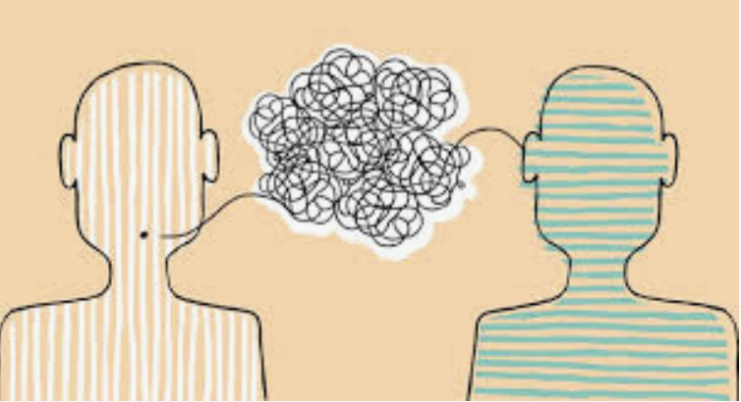
Weaving Virtue Ethics Into Psychotherapeutic Practice
Begins with the acknowledgment of value-laden dialogue with clients
No such thing as value-free dialogue (van Deurzen, 1999)
  Therapists guide individuals to and inform them of better or worse ways to live
Clients come to psychotherapy to explore the ‘gap between the persons they would like to be and the person’s they are’ (Waring, 2012, p. 26)
Virtue ethical therapists are mindful that character development occurs over time
  Clients must habituate into the challenges that cultivate the character strengths they wish to develop to enhance their lives

Slide 14

Weaving Virtue Ethics Into Psychotherapeutic Practice
Discuss psychotherapeutic goals for change
  Begin to make changes in the their lives now that will enable them to live more in accordance with their values and reach their desired tomorrow – reduction of moral dissonance
Exploring the relationship with the self
  Self-love, forgiveness, kindness, justice
What does living in accordance with core values look like for them?
  What does the good life look like?
Therapists (and other practitioners) can weave virtue ethics into practice simply by being attuned to opportunities that afford them ability to open up and unpack virtue ethical themes, such as character strengths, values, and virtues

Slide 15
Weaving Virtue Ethics Into Psychotherapeutic Practice
Wisdom exercises in therapy
  Imagined Future Self
    How do you imagine yourself in the future? What kind of person do you see yourself being? What kind of life do you imagine you will lead? What can you do now to make this more likely?
  Write Your own Eulogy
    If you imagine you died today, what would you like to have read out at the funeral or like to read in your obituary?
  Your 80th Birthday Party
    Imagine you are now 80 years old and a friend or relative is giving a speech, summarising your life, what will you hope will be said?
    Reel Wisdom – Lessons from 40 Films in 7 Minutes

Slide 16
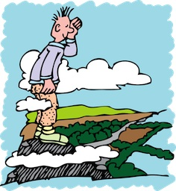

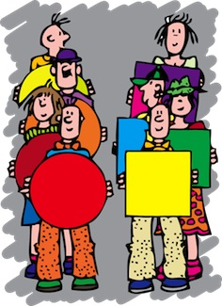
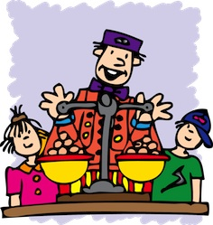
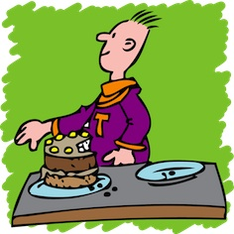
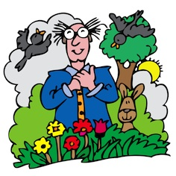
VIA Strengths
VIA – six broad (ubiquitous) virtues – 24 character strengths
  Wisdom and knowledge
    Creativity, Curiosity, Love of Learning, Open-Mindedness, Perspective (Wisdom)
  Courage
    Authenticity (Honesty), Bravery, Persistence, Zest (Enthusiasm)
  Humanity
    Kindness, Love, Social Intelligence
  Justice
    Fairness, Leadership, Teamwork
  Temperance
    Forgiveness (Mercy), Modesty (Humility), Prudence, Self-Regulation
  Transcendence
    Appreciation of Beauty, Gratitude, Hope, Humour, Spirituality

Slide 17
Weaving Virtue & Character Strengths Into Psychotherapeutic Practice
By using the language of virtue and character strengths and highlighting these to clients, we begin to enable clients to consider themselves from this perspective
  Phenomenology
    Name and identify felt/experienced strengths
  How would they like to improve how they are in-the-world-with-others?
  To begin to live the life they desire, they must choose it actively
    Habituate towards the self they want to be

Slide 18
Introducing & Working With Character Strengths
Challenge the negativity bias, enquire over known or experienced positive characteristics
  We require the language to name and spot strengths
Take the VIA
  https://www.viacharacter.org
Results provide rank order of character strengths from 1 to 24, with definitions
  Top five are signature strengths
  Most essential to who you are
Discuss results
  Does the top five look like the ‘real you’?
  What stood out or struck you about the list?
  How do you use your strengths, when, where?
  Can you spot and name a strength
    When do you see it, feel it, or experience using it?

Slide 19
Client Vignette
A 21 year-old student describes herself as being known among her friends as someone who can always be counted on to be ‘brutally honest’ and ‘say how it really is’. The expressed idea of being brutally honest opened up a space for exploring with this client what that means to her – that is, how she defines or understands what it is to be brutally honest. She explained by way of noting, for instance, that she would tell a friend if they really looked good in an outfit or not. Her example opened up the space to consider her self-identification with honesty as a moral virtue and explore from the Aristotelian perspective the difference between using it virtuously and unvirtuously – to consider ‘[t]hat moral virtue is a mean…and in what sense it is so, and that it is a mean between two vices, the one involving excess’ (e.g., insult), ‘the other deficiency’ (e.g., disingenuousness) (Aristotle, c. 330 BCE/1925, p. 45). She was struck by the realisation that insult could be hidden in so called honesty (and humour), which presented the opportunity to consider if telling others the real truth fit with her self-identification and ownership of being an honest person.

Slide 20
Client Vignette
A 24 year-old student expresses valuing honesty as one of their core values. During the session they note that they ‘get away with’ using the same train ticket sometimes for months without having to purchase a new one. Their behaviour stands in contrast to their espoused value of honesty. Challenging them to consider that honesty involves not only truth telling, but also authentic presentation of self to others, and living as an honest person would do (with integrity), offers the opportunity to apply virtue ethics in practice. This client at first presentation of being challenged with regards to their dishonest behaviour became defensive and expressed that a small dishonesty, such as a train ticket, surely did not count. They were open however to considering the difference between believing in honesty and self-identification with it and living the virtue in practice. Therefore, opening up discussion around these themes, which facilitated for this client the unpacking of what authenticity and integrity mean to them, causing them to re-examine their behaviour in light of how they desired to be-in-the-world.

Slide 21
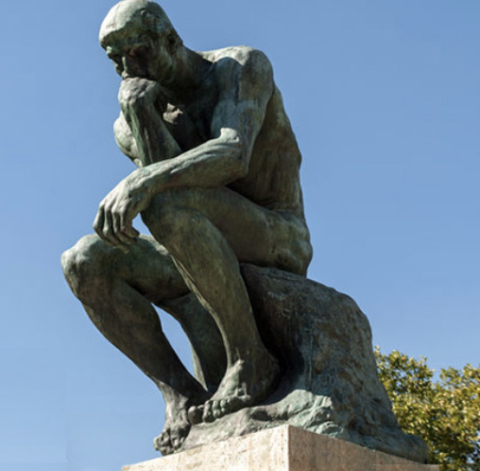
Virtue Ethics: Relevance to Psychotherapy
Fundamental for considerations and explorations of the good life
Practical wisdom – non prescriptive or directive
Psychotherapeutic space enables exploration of what the good life means to the client and how they can move towards it
Inspires and strengthens our use of the psychotherapeutic space to explore how we find meaning
Using the language of virtue and strengths enables clients to consider themselves from this perspective

Slide 22
Thank you!

Slide 23
References
Aristotle. (c. 330 BCE/1925). The Nicomachean Ethics (D. Ross, Trans). New York, NY: Oxford.
Athanassoulis, N. (2016). Virtue ethics. The Internet Encyclopedia of Philosophy, ISSN2161-0002, http://www.iep.utm.edu/virtue/, accessed 24 October 2016.
Dahlsgaard, K., Peterson, C., & Seligman, M. E. P. (2005). Shared virtue: The convergence of valued human strengths across culture and history. Review of General Psychology, 9(3), 203-213.
Niemiec, R. M. (2013). VIA character strengths: Research and practice (The first 10 years). In H. H. Knoop, & A. Delle Fave (Eds.), Well-being and cultures: Perspectives on positive psychology (pp. 11-30). New York: Springer.
Peterson, C. (2006). A primer in positive psychology. New York, NY: Oxford University Press.
Proctor, C. (2019). Virtue ethics in psychotherapy: A systematic review of the literature. International Journal of Existential Positive Psychology, 8(1), http://journal.existentialpsychology.org/index.php/ExPsy/article/view/237/275
Sachs, J. (2016). Aristotle: Ethics. The Internet Encyclopedia of Philosophy, ISSN2161-0002, http://www.iep.utm.edu/aris-eth/, accessed 9 November 2016.
Van Deurzen, E. (1999). Common sense or nonsense: Intervening in moral dilemmas. British Journal of Guidance & Counselling, 27(4), 581-586.
Waring, D. R. (2012). The virtuous patient: Psychotherapy and the cultivation of character. Philosophy, Psychiatry, & Psychology, 19(1), 25-35.
Wong, P., & Reilly, T. (2017). Frankl’s self-trancendence model of virtue ethics. Retrieved from: http://www.drpaulwong.com/frankls-self-transcendence-model-and-virtue-ethics/

